Slide 1
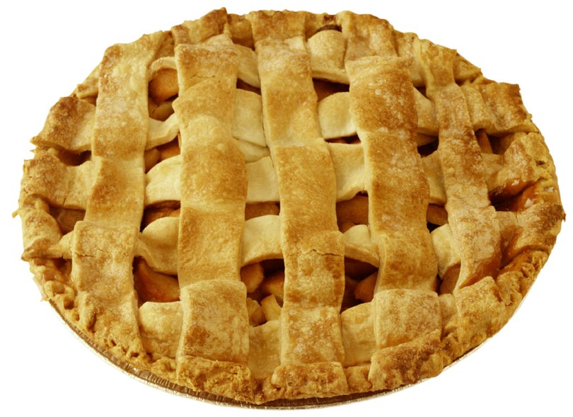
Homemade
Apple Pie
Bake Sale – Saturday January 20

Slide 2
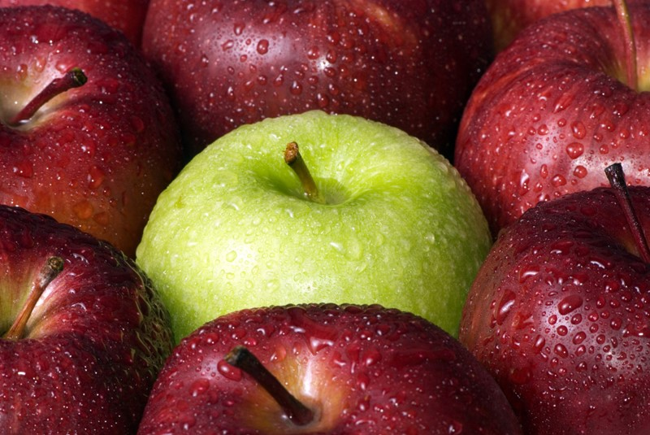
Choose the Right Apples
Jonathan
Honeycrisp
Granny Smith
Winesap
Braeburn
Rome Beauty

Slide 3
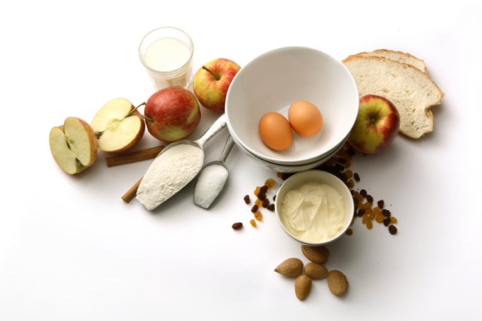
Ingredients
2 pie crusts for a 9-inch pie
¼ cup all-purpose flour
¾ cup granulated sugar
½ tsp. ground cinnamon
½ tsp. ground nutmeg
Dash of salt
2 tbs. butter
6 cup thinly sliced apples
Use Fresh Ingredients

Slide 4
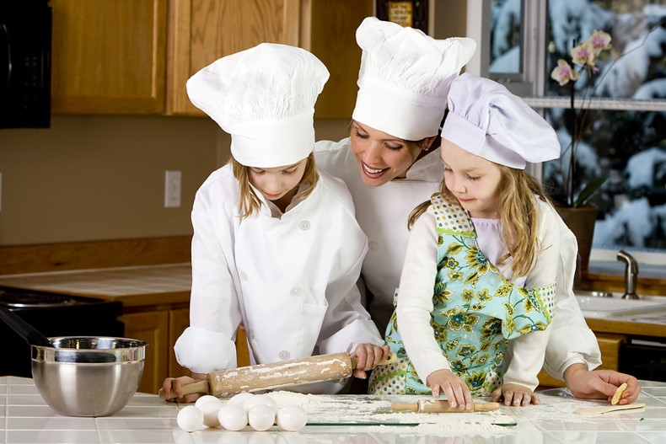
Directions
Preheat oven to 425 degrees F.
Place crust in bottom of pie pan
Mix dry ingredients
Stir in apples
Place into pie crust
Dot with butter
Place second crust on top
Seal top crust to bottom
Slit top crust with knife
Bake 40 to
50 Minutes

Slide 5
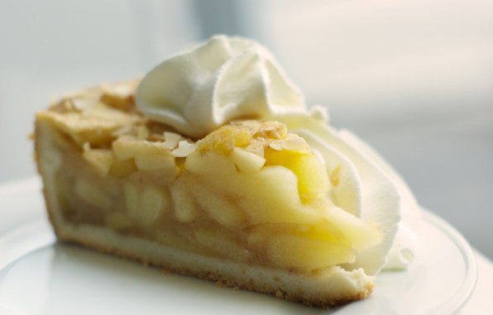
Try a Slice with
Whipped
Cream

Slide 6
Bake Two Pies
Donate One to Our Bake Side – January 20

